Slide 1
INTRODUCTION: SYSTEMS, CYCLES, RESERVOIRS, AND FLUXES
❖ Earth as a system :
The basic idea of a system is that it is something that consists of
(i) a number of distinctive and diverse parts that function together by a variety of interactions and
(ii) exchanges of energy and matter.
❖ Cycle
A cycle might best be described as a characteristic succession of events and processes , involving certain kinds of Earth materials, by which the materials reside in certain kinds of places and move among such places in certain ways. Cycles operate through an indefinitely long span of time.

Slide 2
Reservoir
In Earth systems science, the term reservoir is used for a distinctive kind of place where a certain kind of material is stored, or resides for some period of time.
examples of near-surface reservoirs :
the atmosphere;
glaciers;
the soil layer;
the aggregate of bodies of fresh water on the continents (rivers and lakes).

Slide 3
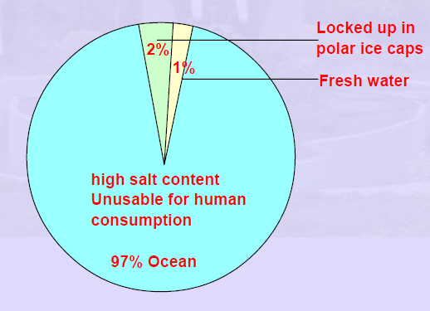
Distribution of earth's water supply

Slide 4
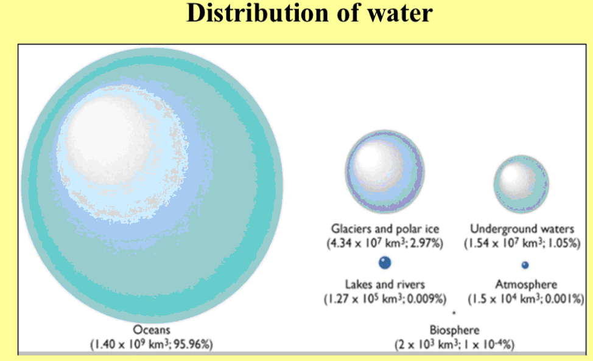

Slide 5
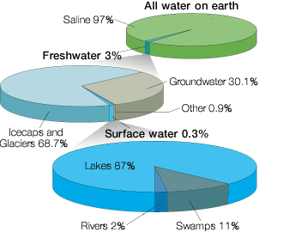
Global Water Distribution
71% of the Earth’s surface is covered in water
97% of that water is salt water in ocean and seas
77% of the fresh water on Earth is frozen in icecaps and glaciers
Fresh water is a limited resource because there is only about 3% usable freshwater.

Slide 6
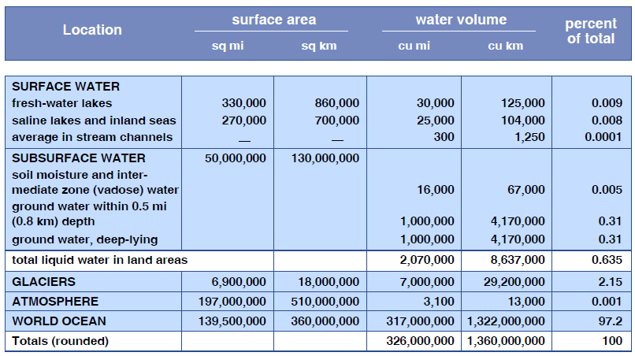
An accounting of where the Earth’s water resides.
This Table doesn’t tell anything about the movements and transformation of the earth’s water.
You all know that water on, below, and above the earth’s surface is in a continuous state of movements and transformations. The picture of these movements and transformations is called the water cycle or the hydrologic cycle .

Slide 7
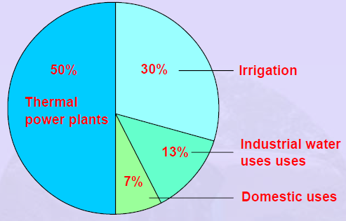
Major use of fresh water
Up to 60% of the human adult body is water (The average adult human body is 50-65% water, averaging around 57-60%; They form around 80 percent of the body weight.)

Slide 8
Geochemical cycles
THE HYDROLOGIC CYCLE,

Slide 9
Water and the atmosphere
Water enters the atmosphere through evaporation, transpiration, excretion and sublimation:
Transpiration is the loss of water from plants (via their leaves).
Animals excrete water by respiration and by passing urine.
Sublimation is when ice or snow transforms directly into water vapour without going through a liquid phase (i.e. they do not melt).
Once the water is in the hydrosphere or geosphere, it can be used by living things. Plants can take water from the soils, and animals can drink water from rivers and lakes or eat plants. Even microbes deep in the ground live in tiny films of water surrounding rocks. The water will then stay in the biosphere until released through evaporation, transpiration, excretion, decay, respiration and combustion and the whole process begins again.

Slide 10
HYYROLOGIC CYCLE:
Water from the oceans, rivers, and lakes evaporates to become water vapor. Warm air is able to hold more water vapor than cool air so as convection in the troposphere moves air upward, the water vapor will condense at the cooler altitudes. The cloud droplets will grow as they pick up more water vapor. Eventually, the cloud droplets grow so large that the cooler air cannot hold them anymore and they fall to the surface. The rainwater runs downhill starting out as streams that flow into small rivers that in turn flow into large river down to the oceans. Water also percolates into the soil to become part of the groundwater that totals approximately 10% of the mass of the oceans. Some of the groundwater collects in reservoirs underground called aquifers. Groundwater can remain in aquifers for a million years or more. Some aquifer water can reach the surface and flow out to the oceans. Water that falls as snow can also store water for long periods of time as ice sheets and glaciers near the poles or a high elevations.

Slide 11
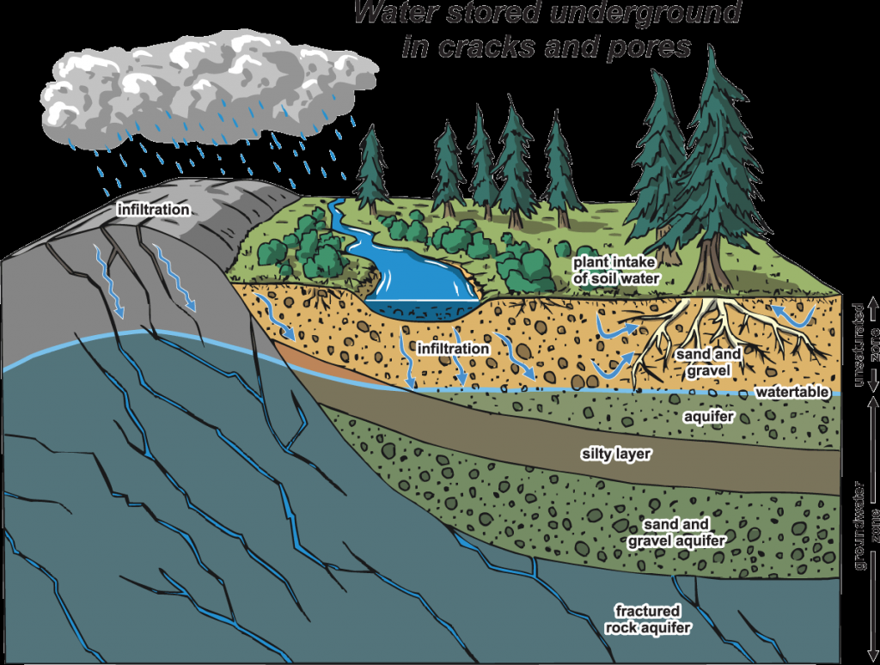
Water stored underground is called groundwater.
Groundwater is found within underground aquifers (in the "zone of saturation“). A zone of saturation is located where water fills in all of the spaces that are in the lower layers of soil. An aquifer is the area underground where spaces between gravel, sand, clay, or rock fill with water.

Slide 12
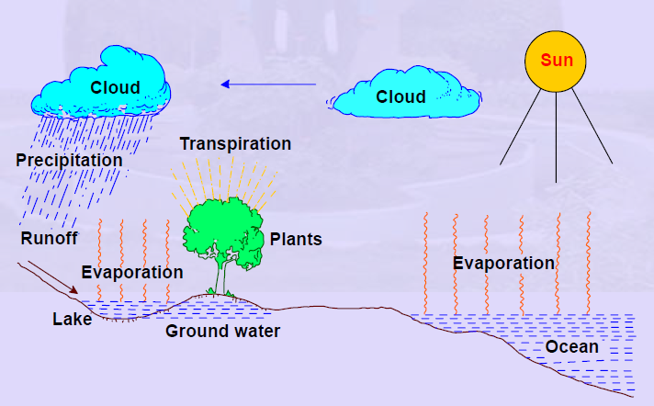
there is more evaporation than precipitation and over the land, there is more precipitation than evapotranspiration
About 4 × 10¹³ m³ more water falls on land as precipitation than evaporates from it (the difference between evapotranspiration and precipitation on land) and this is the water that is returned to the oceans through stream flow

Slide 13
INVOLVEMENT OF BIOSHPERE IN WATER CYCLE
Plants
Of all living organisms, plants contribute the most to the water cycle.
❖ To produce their energy, plants perform photosynthesis, in which plants draw water from the surface and/or from under ground with their roots.
❖ A great deal of evaporates from the surface of the leaves. This type of plant-water evaporation is called transpiration. Transpiration from the tree canopies in forests plays a huge part in the water cycle; in fact, about 10 percent of all water vapor cycled back into the atmosphere is from plant transpiration.
Animals
❖ Both plants and animals produce water as a byproduct of respiration. During breathing out water vapors are released to the atmosphere.
Some of the water is excreted out (through urination and sweating) and the rest of water is released when the organism dies.
A 70-kg man is made up of about 42L of total water.

Slide 14
Green House effect : Water Vapor
Water vapor, high specific heat, is a major factor in greenhouse effect.
Major role in maintain temperature at night when Earth does not receive energy from the Sun
Ex: Desert areas (low H₂O (g) concentration) have very hot days and very cool nights

